Slide 1
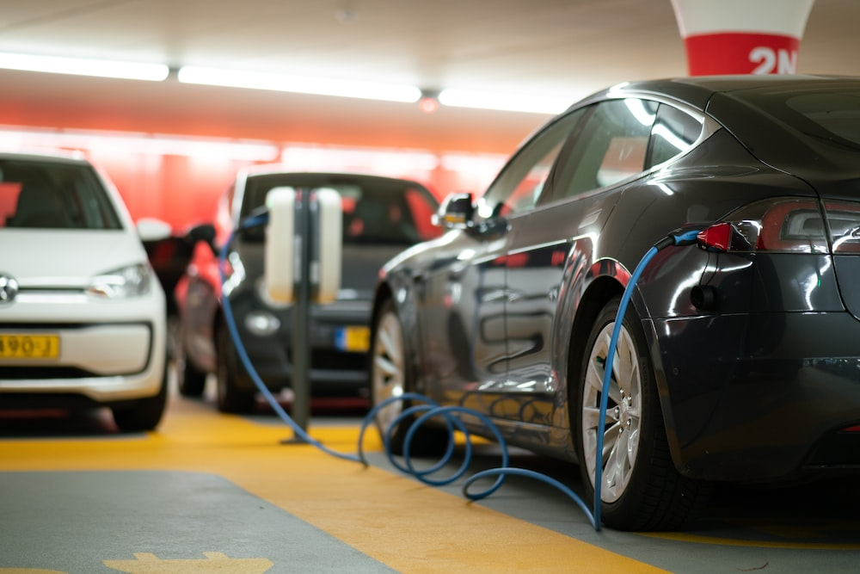
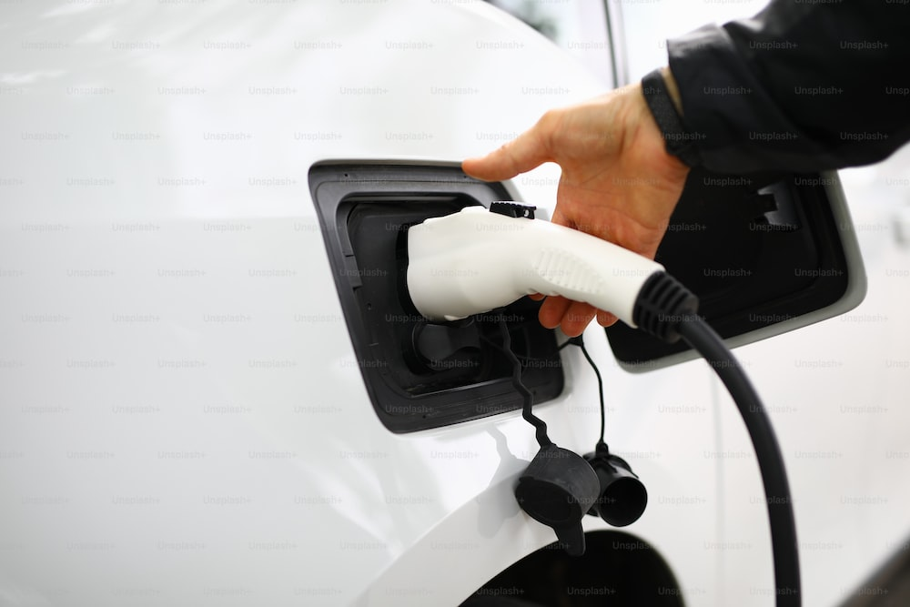



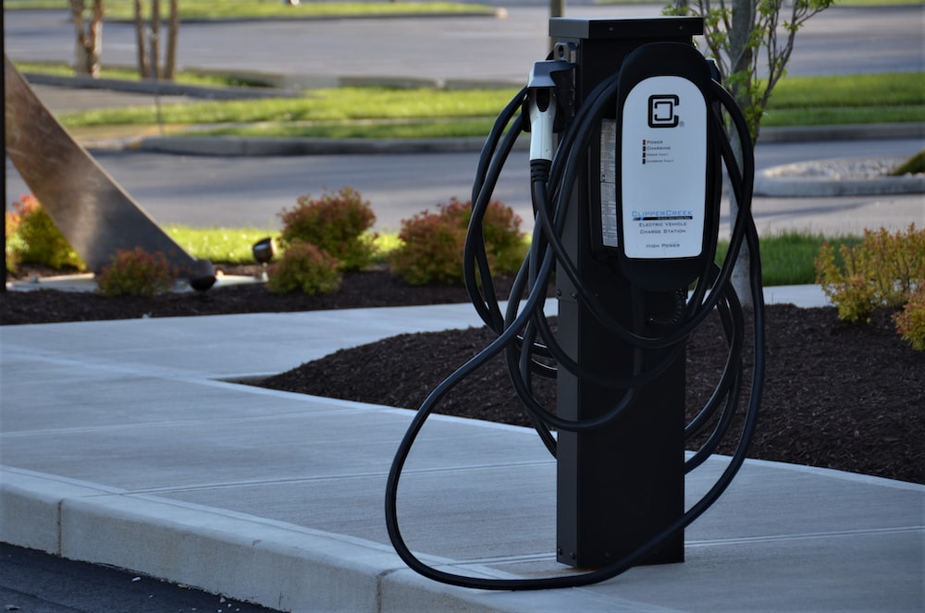
UTC-7SPC Meeting
Analysis of EV Charging Stations Exploring Viability, User Behavior, and Station Utilization

Slide 2
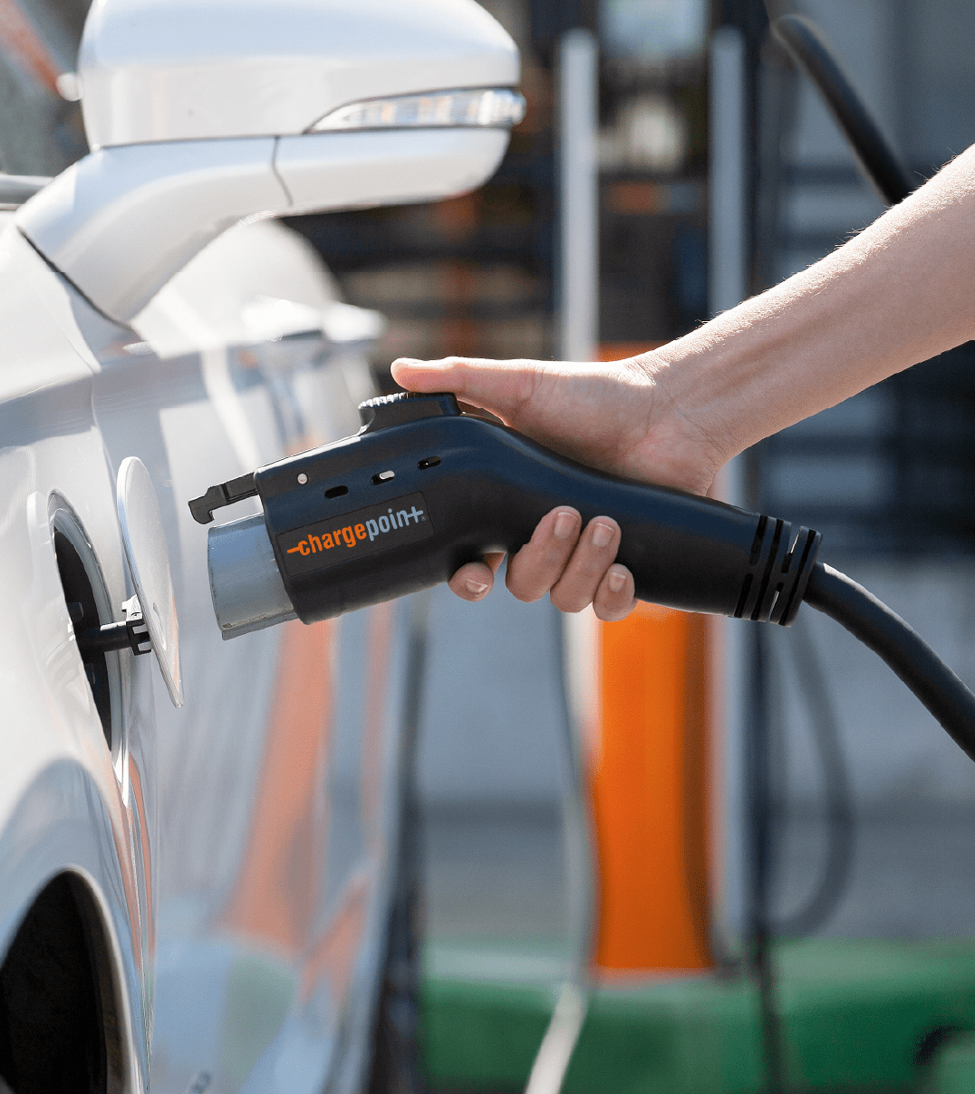
How to measure the viability of Level 2 and DC fast charging sites in 5 years (after grant funding, which sites will be worth investing in to keep running)
What is the optimal power per port ratio in Urban vs Rural vs Interstate locations? When does adding more power to a site have diminishing returns?

Slide 3







Viability of Level 2 and DC fast charging sites
Data Gathering

Slide 4
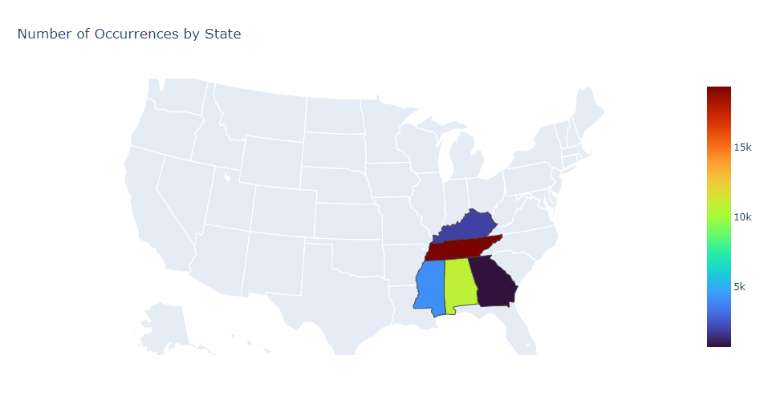
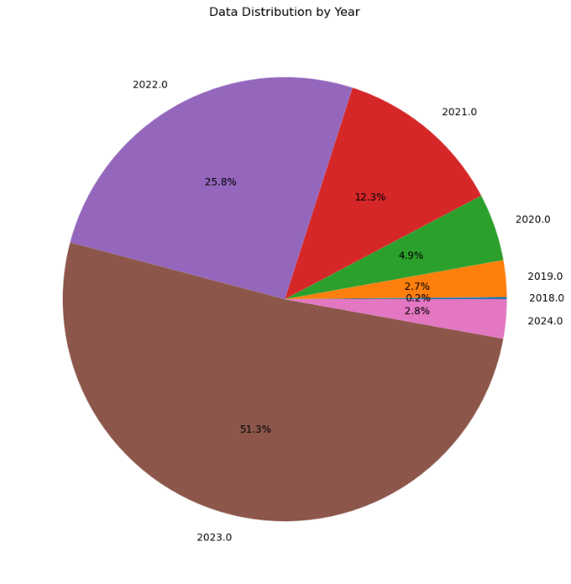
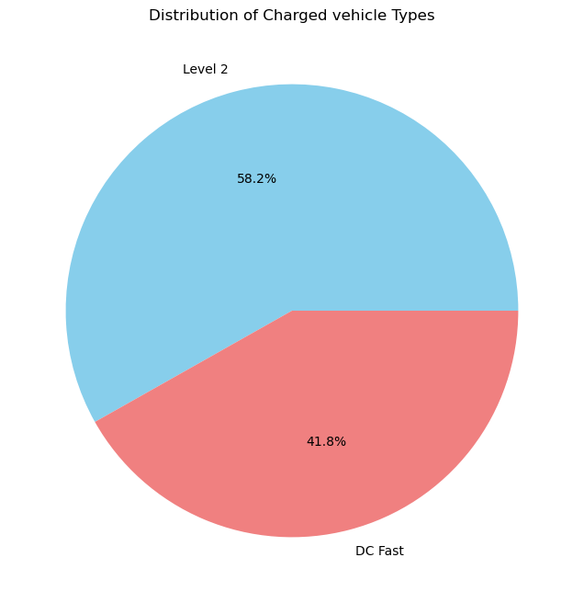
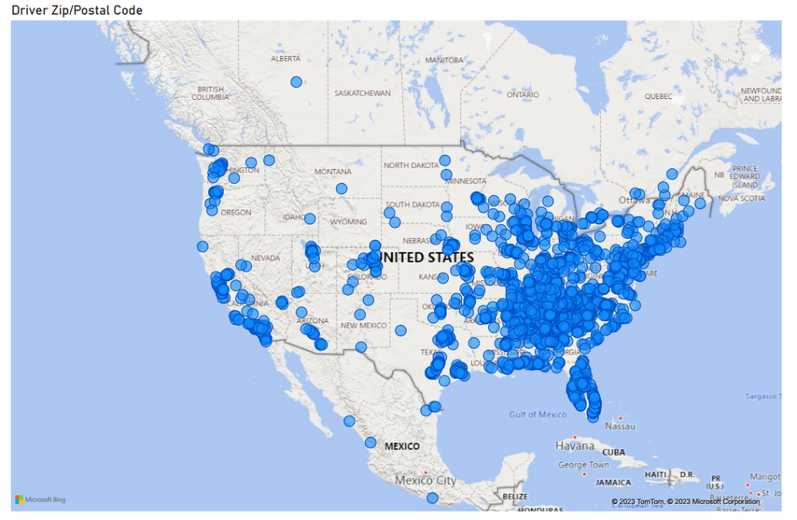
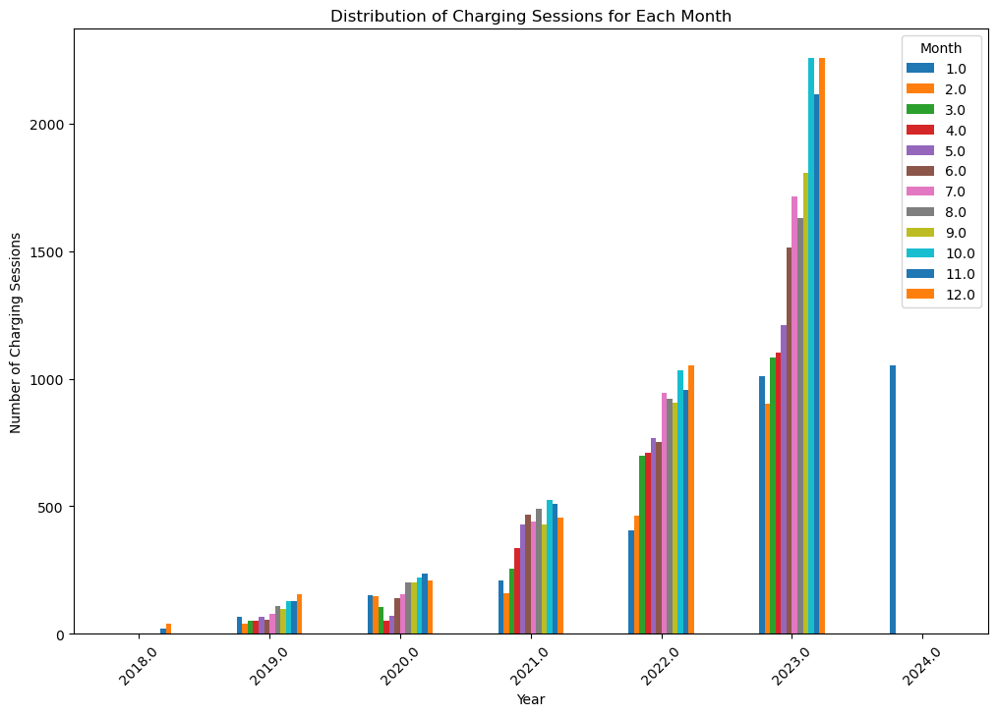
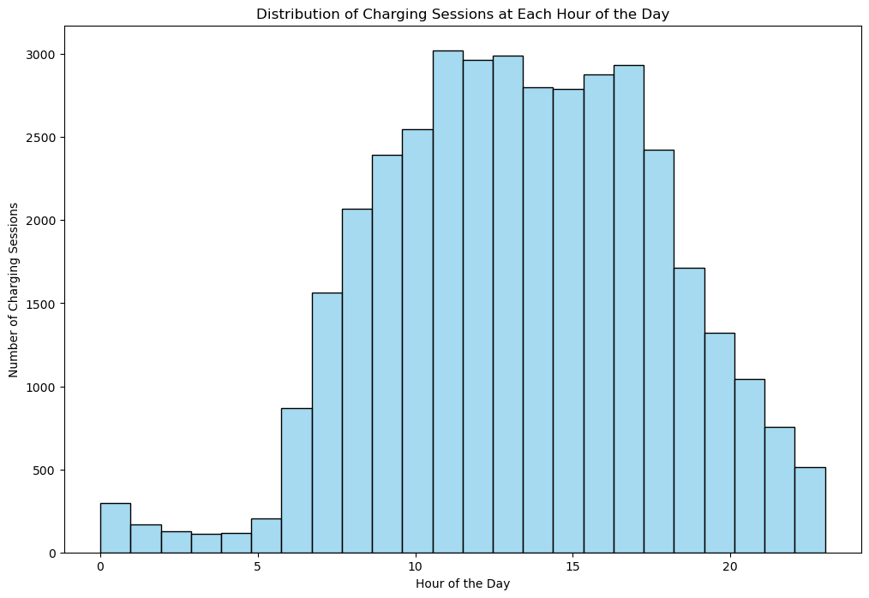
Distribution of data
Distribution by year
Distribution of vehicle type
State
Tennessee 19372
Alabama 10803
Mississippi 4146
Kentucky 1931
Georgia 691
Charging Session Over Time
Contribution of Charging Session during the day
Driver Zip Code

Slide 5
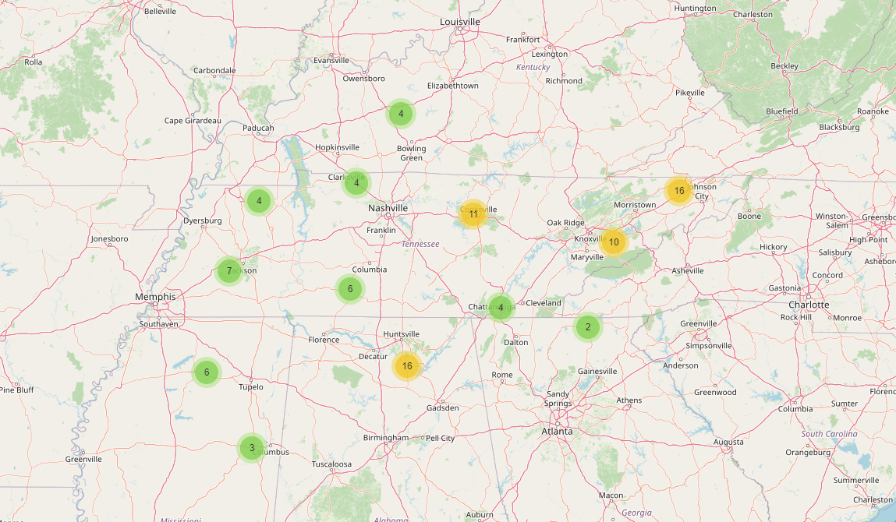
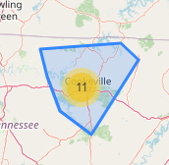
Charging station locations

Slide 6


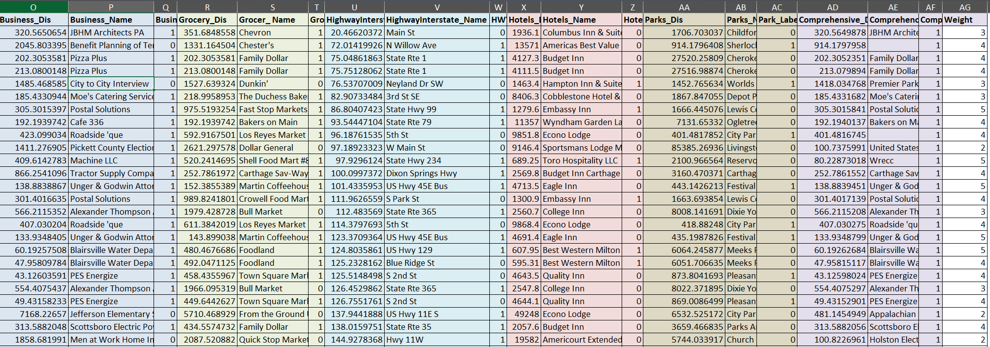
Data fusion- Charging Venue Analysis
Understanding the distribution of electric vehicle charging stations across different venues provides valuable insights into the accessibility and strategic placement of charging infrastructure.
Walking distance
A list of potential charging venues, including hotels, leisure facilities, medical centers, city halls, offices, parking areas, retail establishments, and transit hubs, Hwy,…
Charging Venue
CS (Lat, Long)

Slide 7



Data Analysis
User Data
CS Data
Charging Time
Location
EVSE ID
Event Type
Parking Time
Number of Ports
POI-Venue
Charging Status
Ports Type (L2/DCFC)
Service Time
User Zip Code
Idle Time
Out of Service Time
Delivered Energy (kWh)
D/W/M/Y Delivered Energy
Free/Paid
Fee
Hidden Demand
Current Demand
Start Charging
End Charging
Leaving CS
Start Charging
End Charging
Leaving CS
Charging
Parking
Idle time
Charging
Parking
Total duration
Timeline

Slide 8
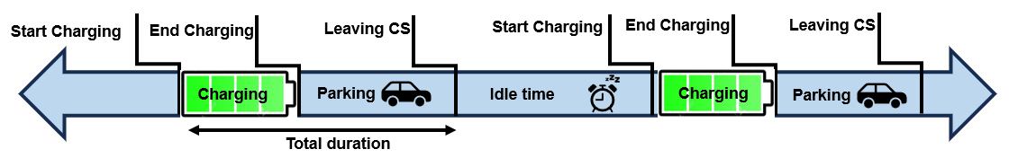
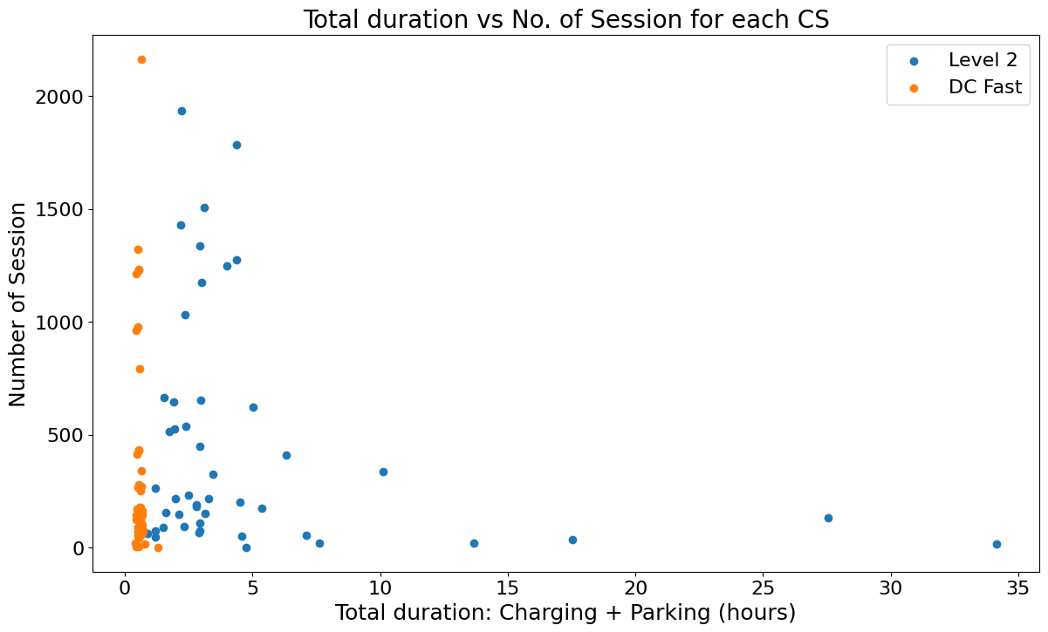
Decision Making
Measure the viability of Level 2 and DC fast charging sites:
Study of user's behavior, charging time, parking time, related to each CS and POI
Each point represent the average charging + parking time at each EVSE

Slide 9
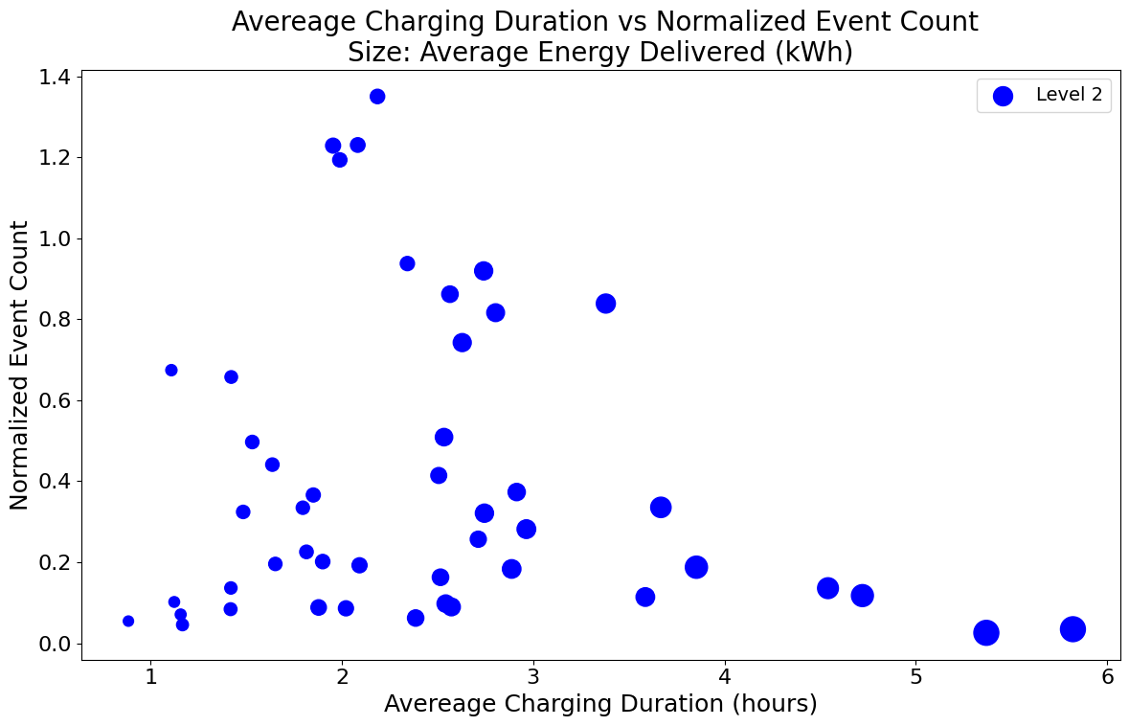
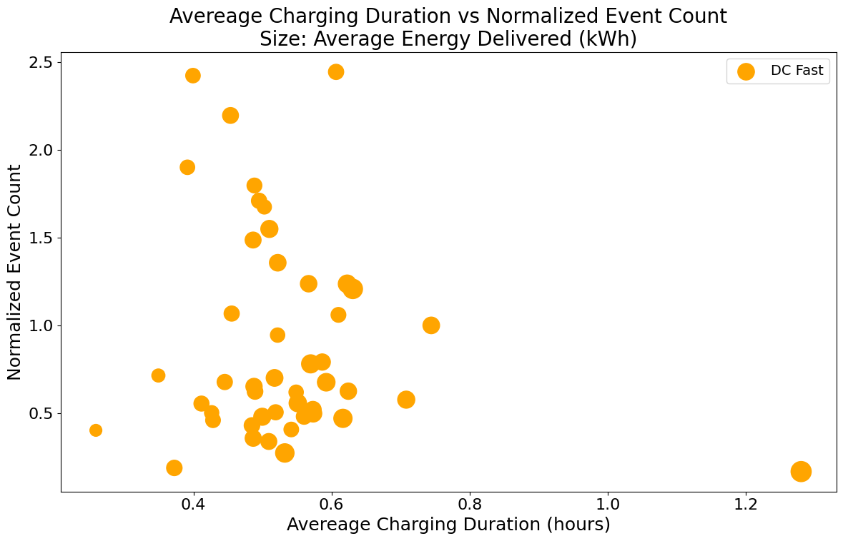
Decision Making
Each point represent the average charging time and the size is average of delivered energy (kWh) at each EVSE
Less charging time
+
lower demand
Less charging time
+
lower demand
EVSE ID: 5498461
Av. charging time: 48 min
Number of session: 63

Slide 10
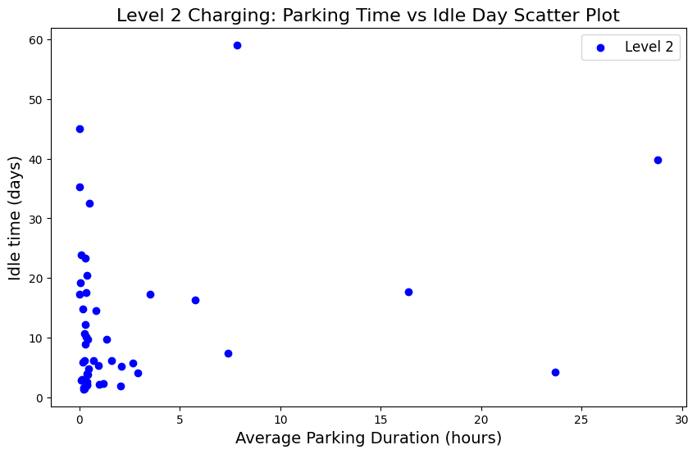
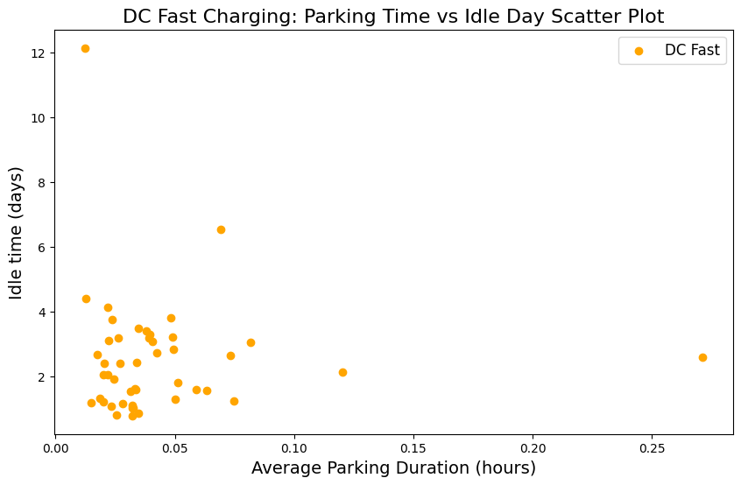
Decision Making
Idle time is the time between two session which is not any EV pugged in and charging port is empty
Area with high parking time and lower demand

Slide 11
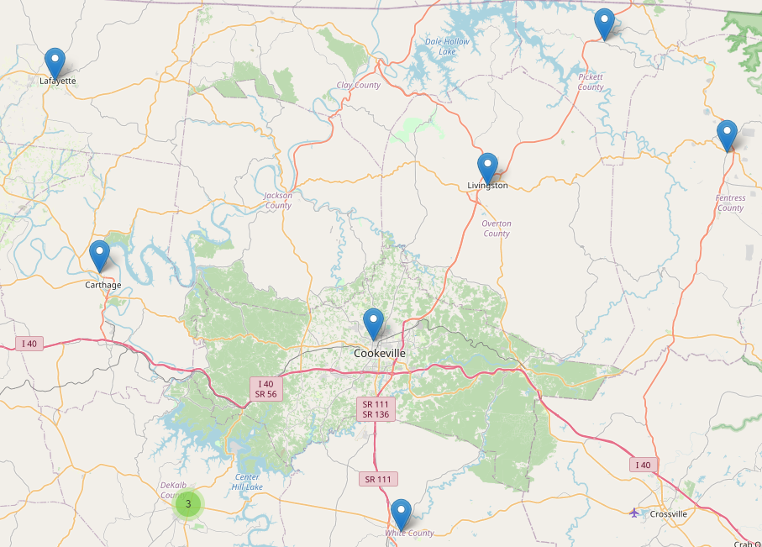



Decision Making
What will happen if we decide to run out a Charging Station?

Slide 12
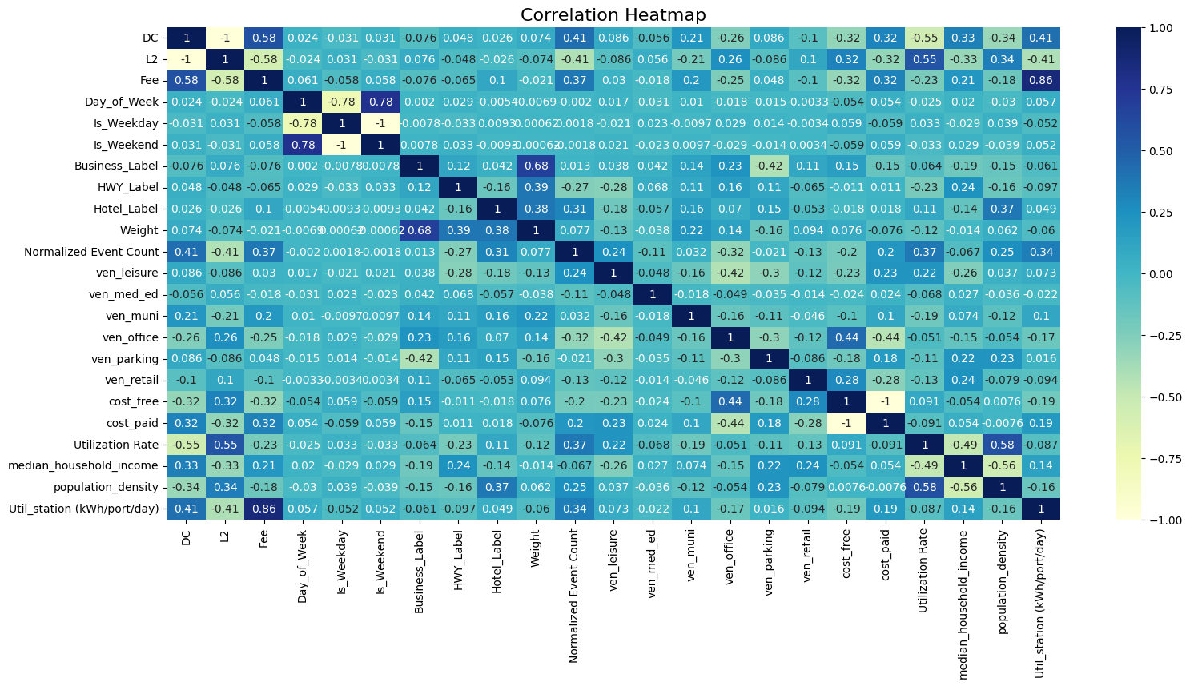
Data processing
Machine learning
station utilization prediction (kWh/port/day)
Row data
Random Forest:
Prediction
Train Score = 0.86
Test Score = 0.83
Val Score = 0.82
Correlation heatmap

Slide 13
What additional studies , we will consider

Slide 14

Questions and Discussions

